Slide 1
NH-2
(AGRA - DELHI HIGHWAY)

Slide 2
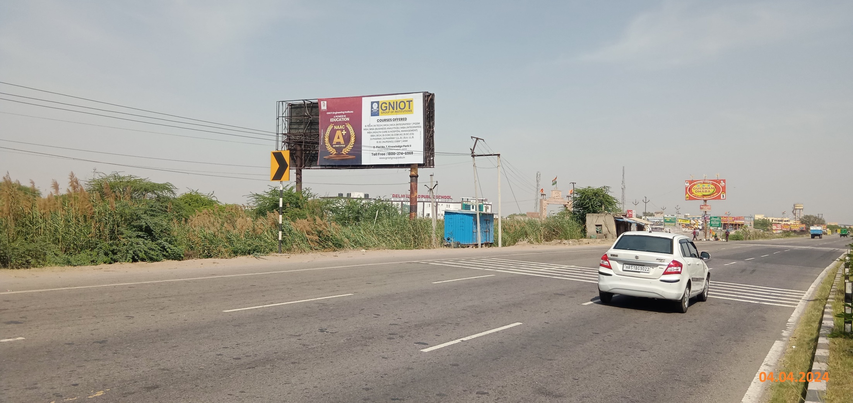
Kotwan Border, Facing Agra 35x20

Slide 3
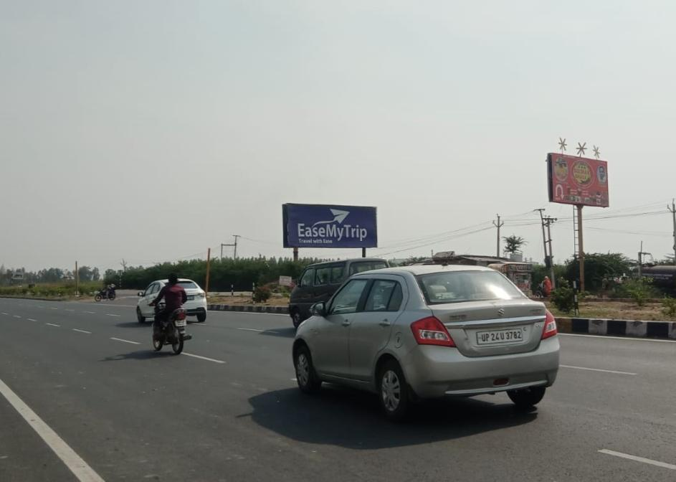
Kotwan Border, Facing Delhi 50x20

Slide 4
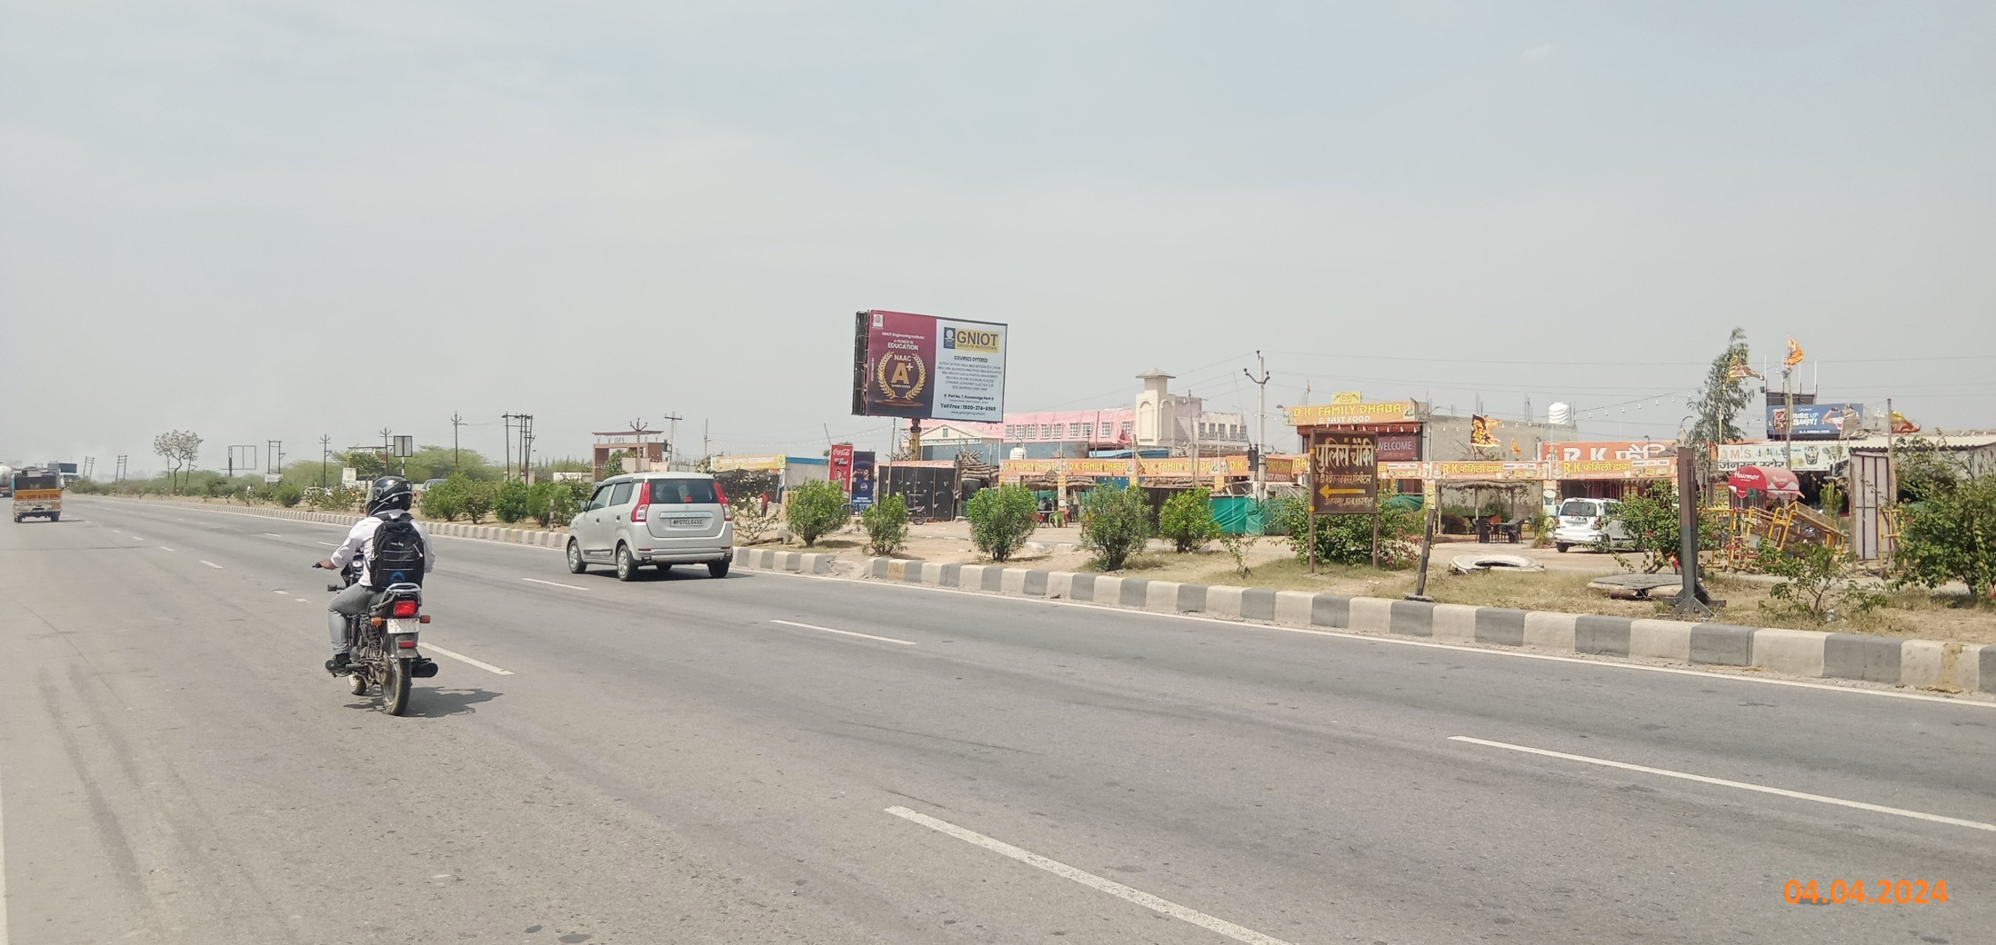
Opp. GL Bajaj, Akbarpur, Facing Agra 32x20

Slide 5
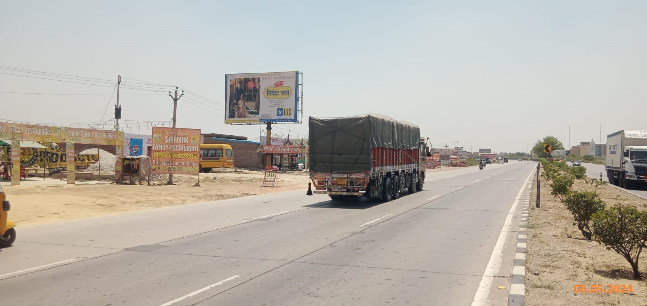
Opp. GL Bajaj, Akbarpur, Facing Delhi 32x20

Slide 6
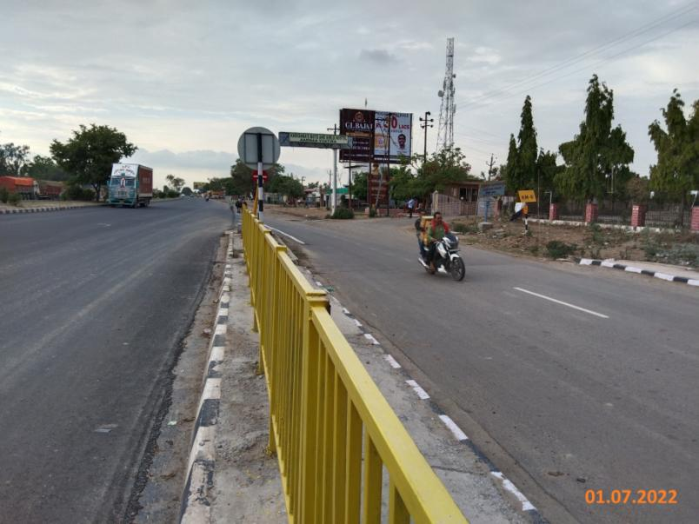
Chowmuha, Near GLA Amarapali, Facing Agra 30x20

Slide 7
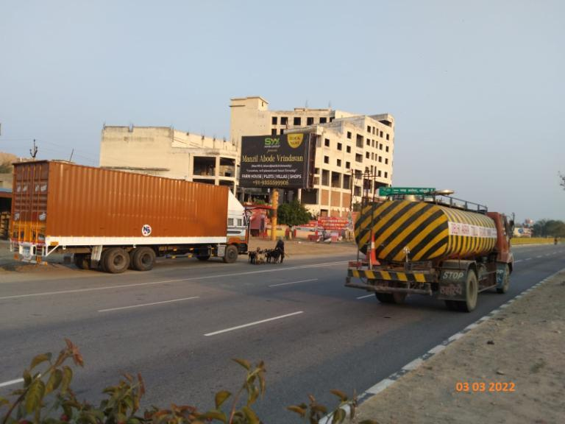
Chowmuha, Near GLA Amarapali, Facing Delhi 30x20

Slide 8
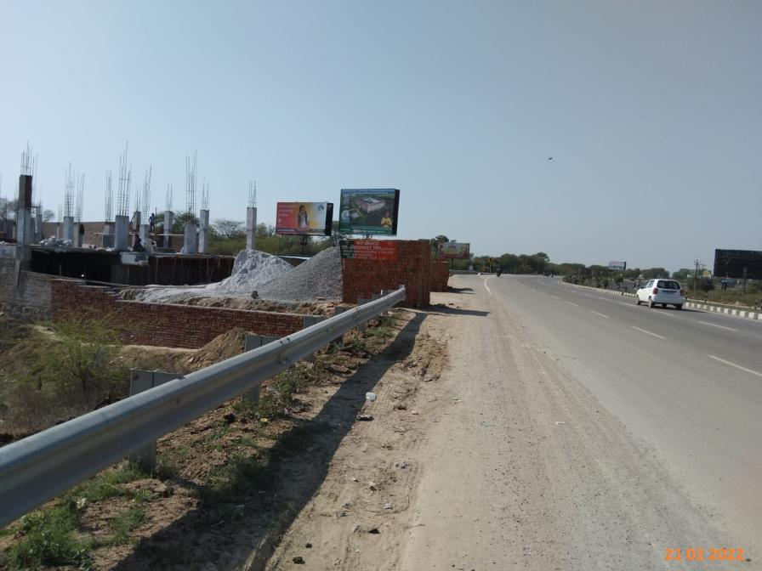
Jaint, Facing Agra 30x15

Slide 9
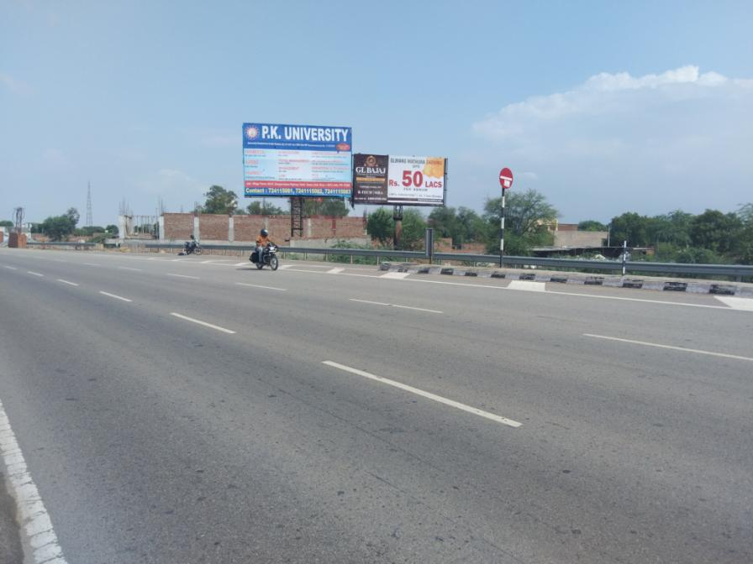
Jaint, Facing Delhi 30x15

Slide 10
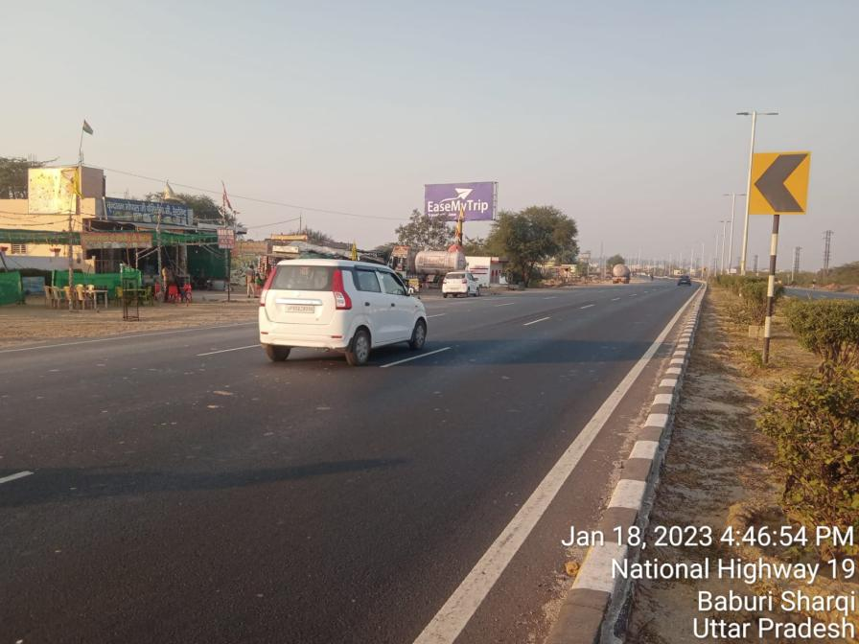
Baad, Facing Agra 30x15

Slide 11
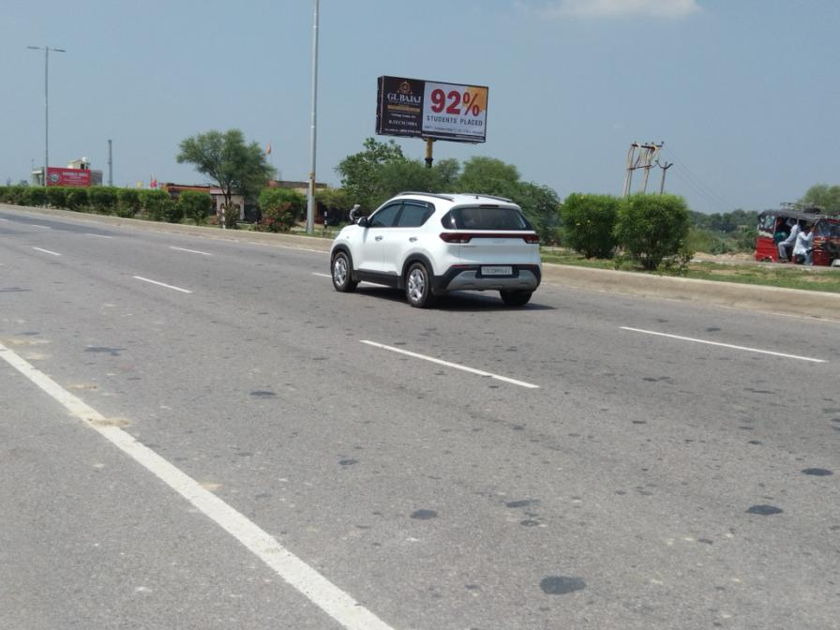
Baad, Facing Delhi 30x15

Slide 12
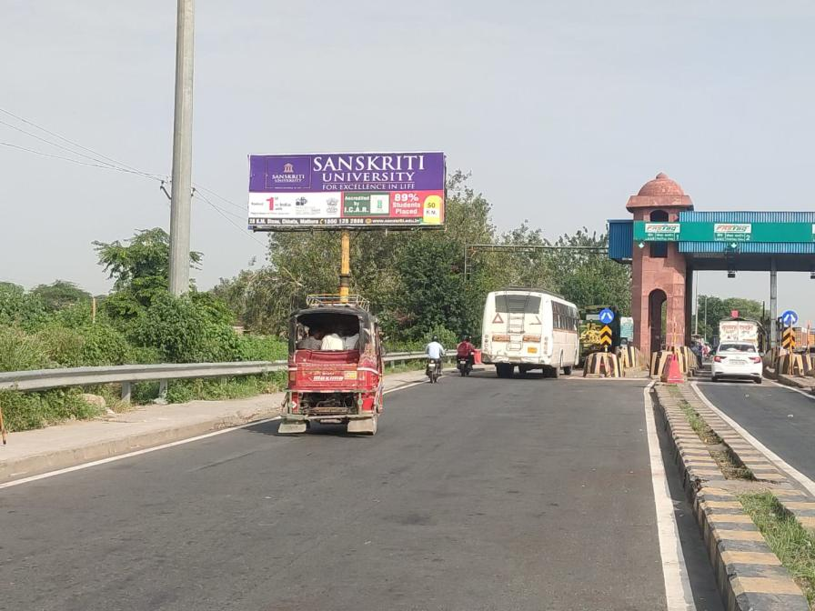
Farah Toll, Facing Agra 40x15

Slide 13
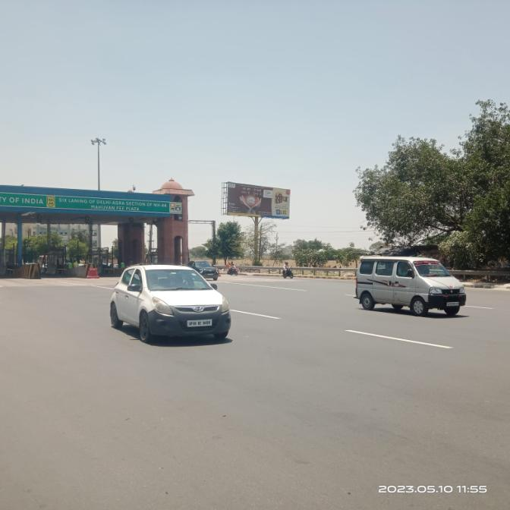
Farah Toll, Facing Delhi 40x15

Slide 14
THANK YOU

