Slide 1
TUNDLA

Slide 2
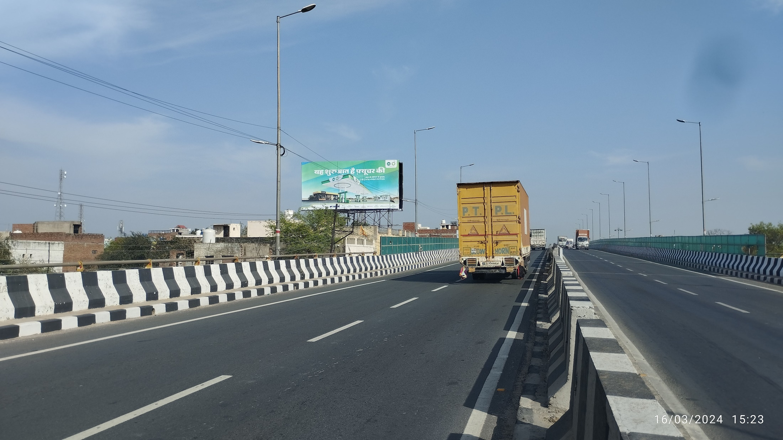
Fly Over Tundla Chowk NH-2, Facing Agra, Tundla 40X20

Slide 3
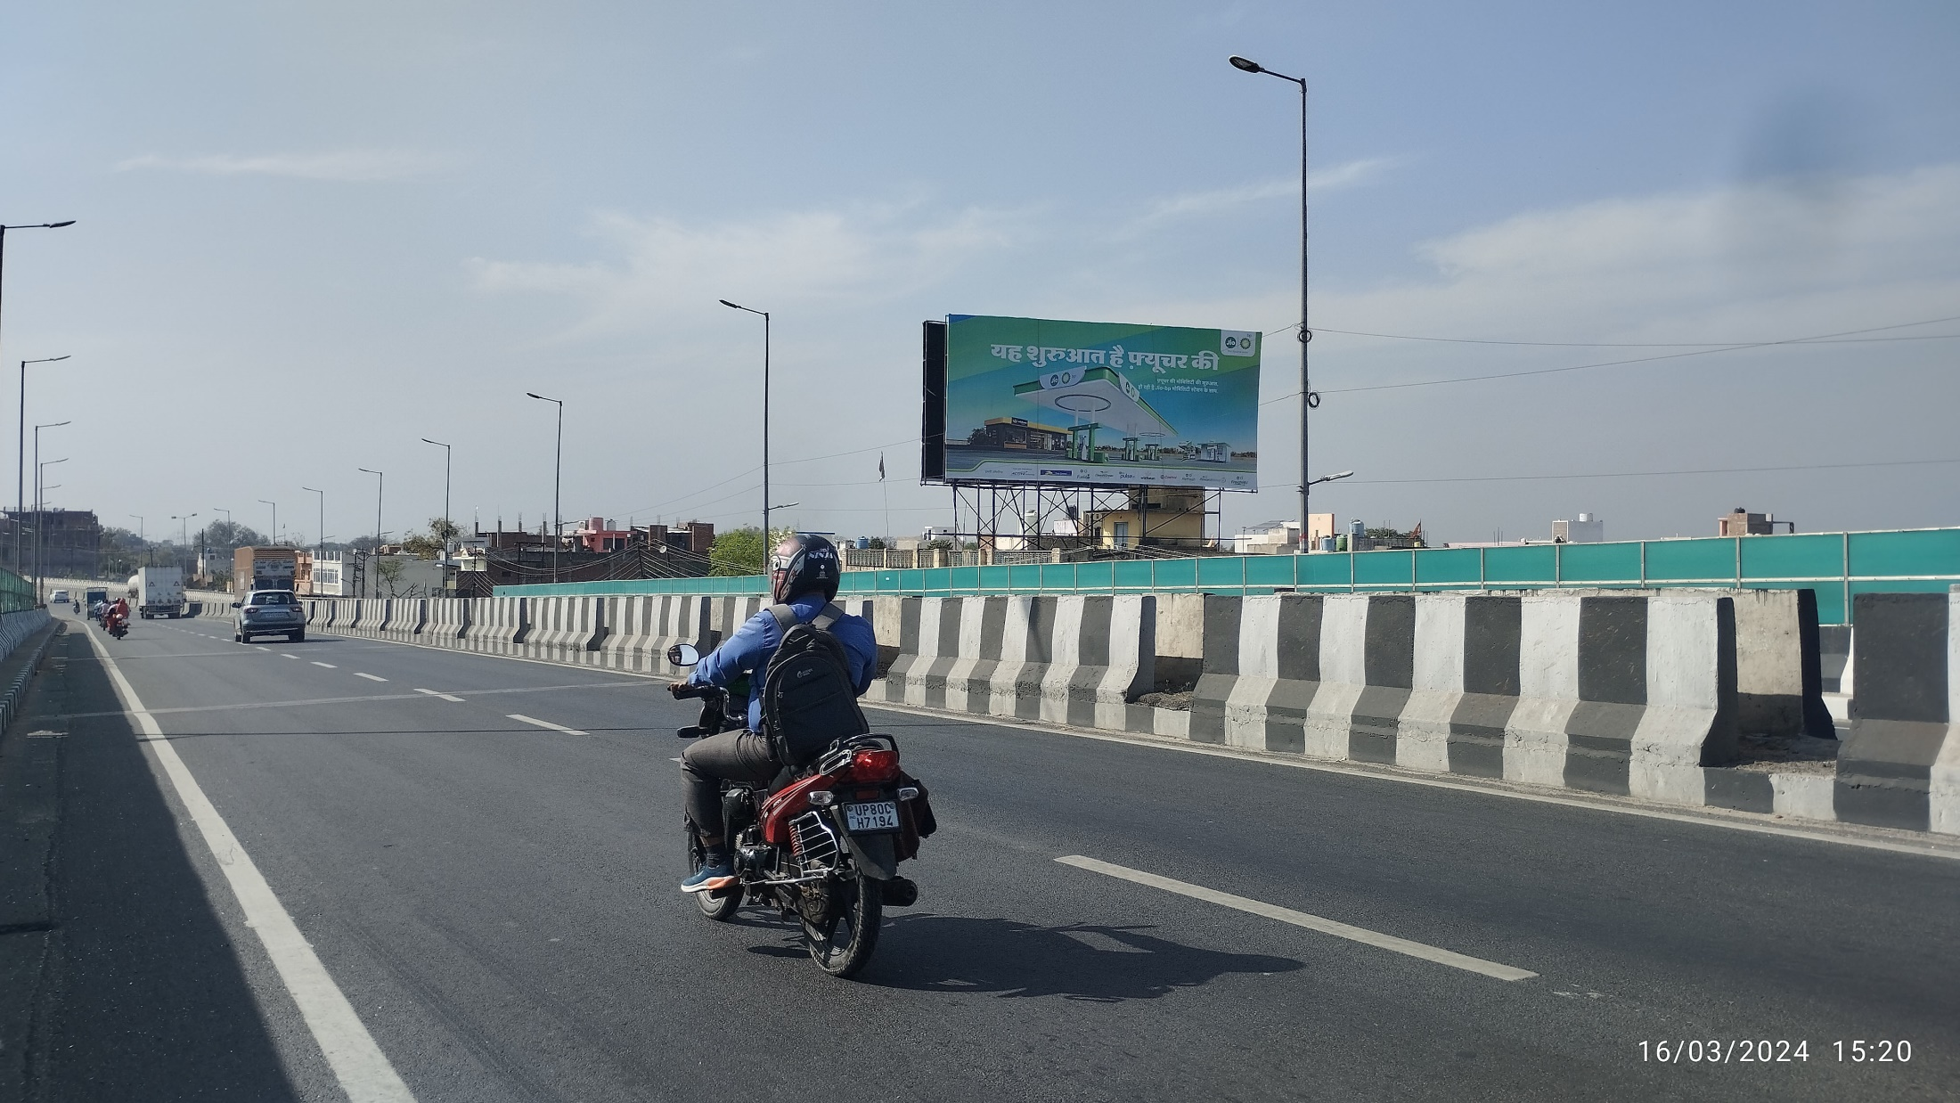
Fly Over Tundla Chowk NH-2, Facing Kanpur, Tundla 40X20

Slide 4
FIROZABAD

Slide 5
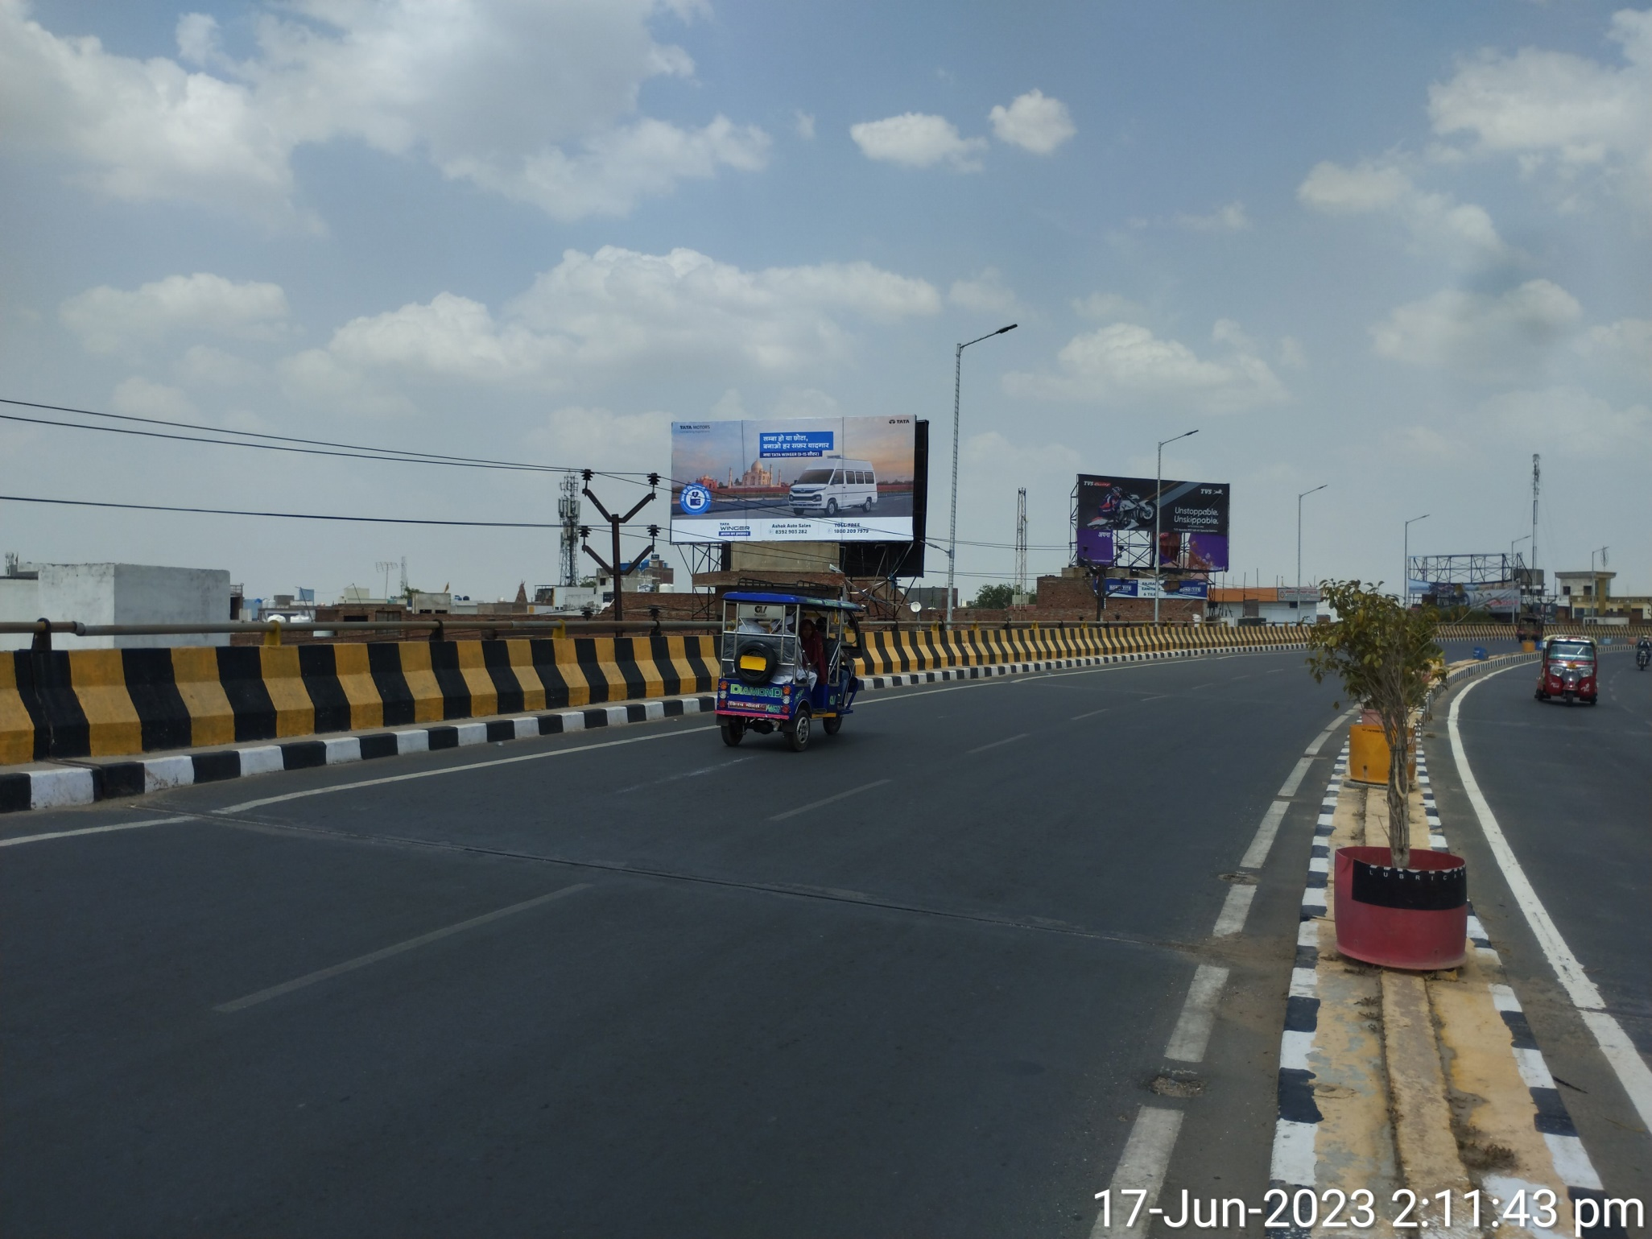
Kotla Chungi Flyover NH-2, Facing Agra, Firozabad 40X20

Slide 6
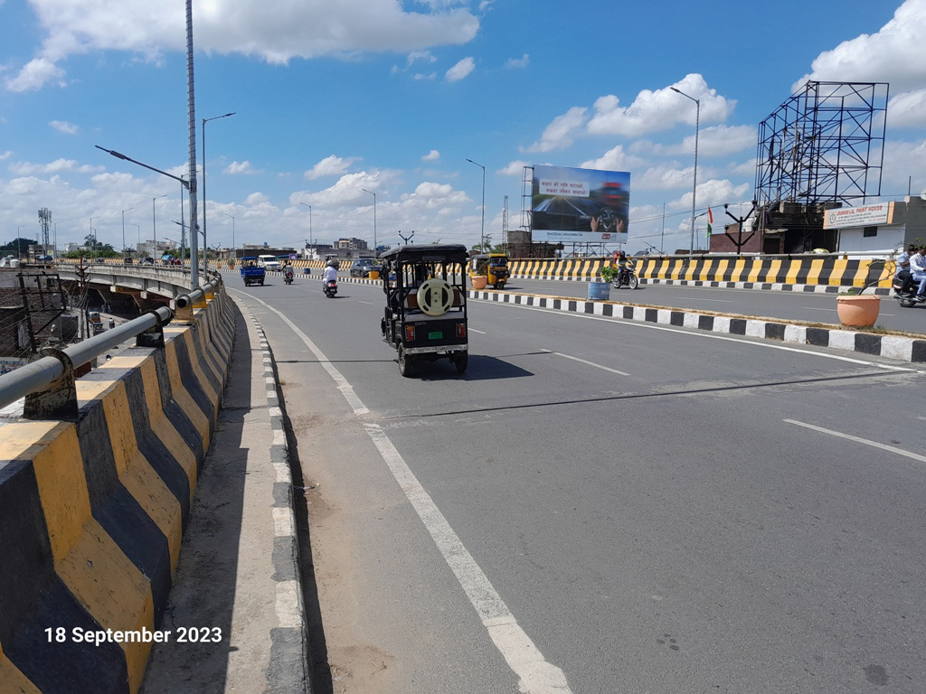
Kotla Chungi Flyover NH-2, Facing Kanpur, Firozabad 40X25

Slide 7
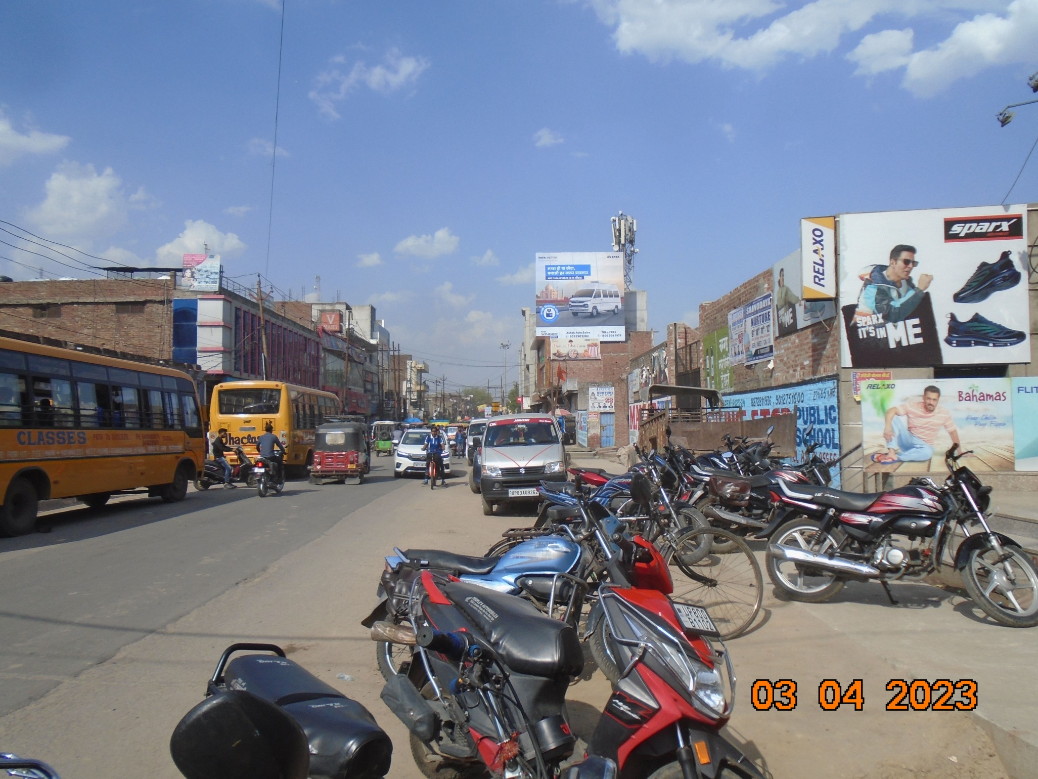
Karbala Chowraha, Opp. V-Mart, Facing Railway Station, Firozabad 30X30

Slide 8
THANK YOU

