Slide 1
VRINDAWAN

Slide 2
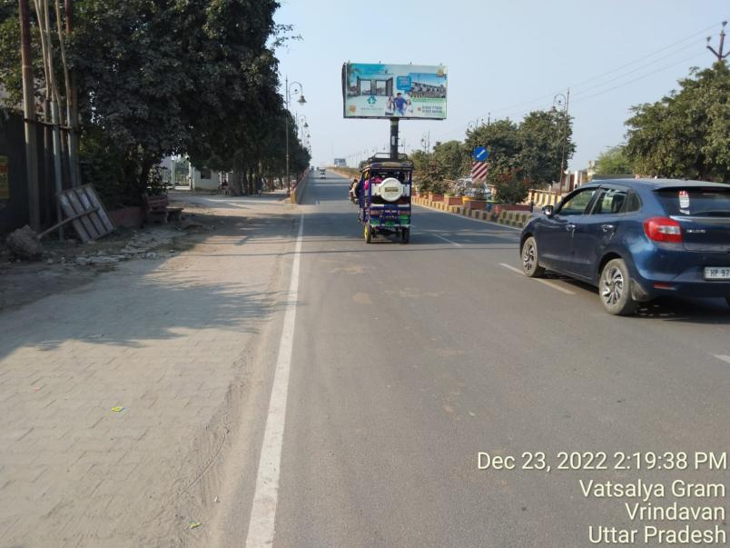
Chaitanya Vihar Pull City, Chattikara Vrindawan Road Facing Mathura 30X15

Slide 3
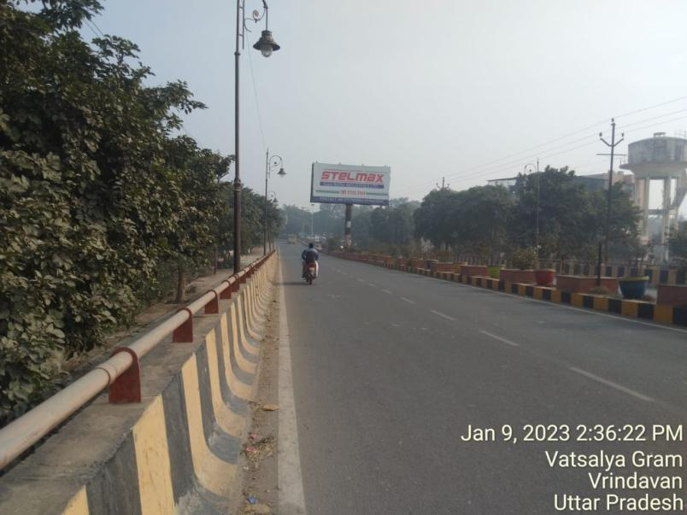
Chaitanya Vihar Pull City, Chattikara Vrindawan Road Facing Prem Mandir

Slide 4
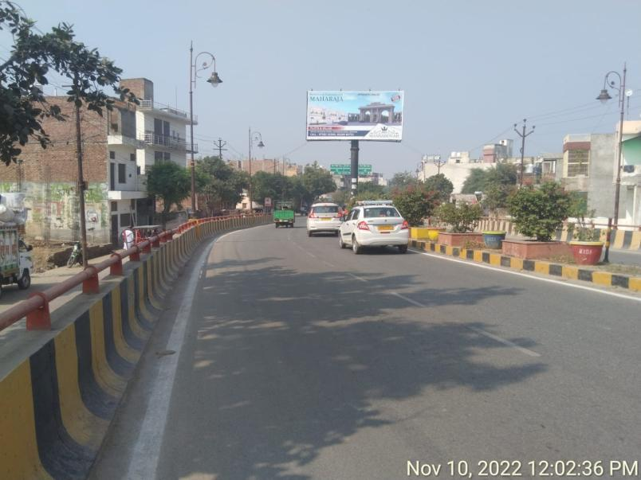
Near Prem Mandir, Facing Mathura 30X15

Slide 5
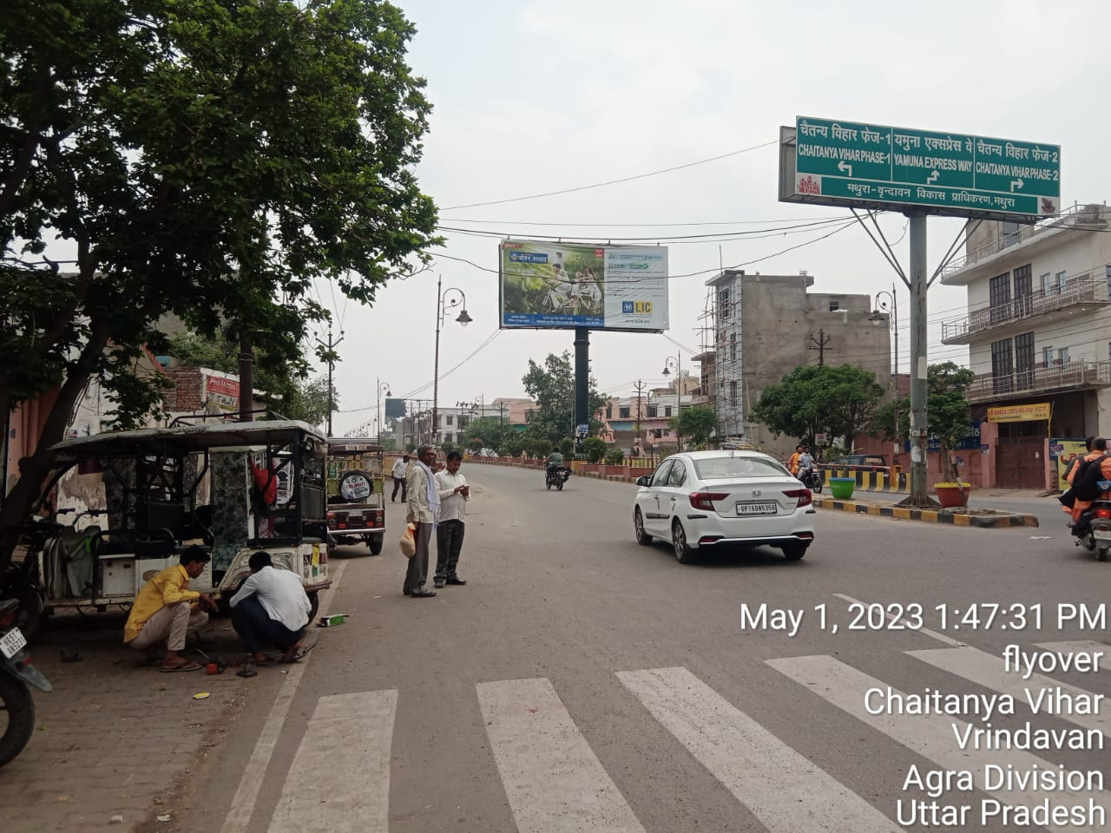
Near Prem Mandir, Facing Prem Mandir 30X15

Slide 6
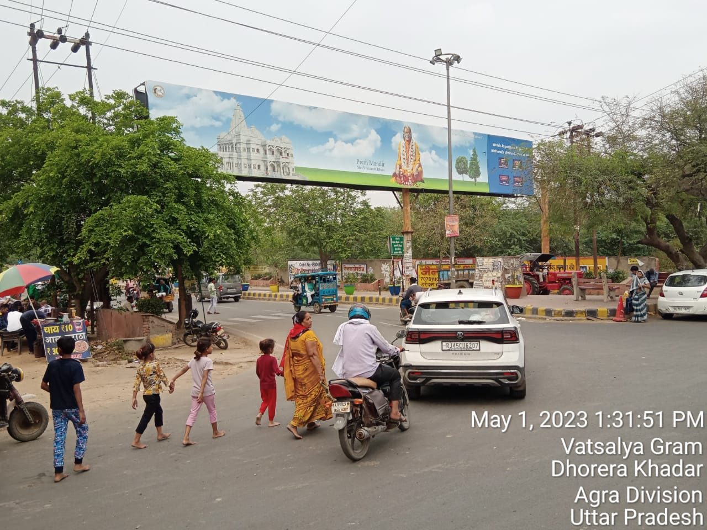
Maya Wati Hospital, Mathura-Vrindawan Road Facing Mathura 70x10

Slide 7
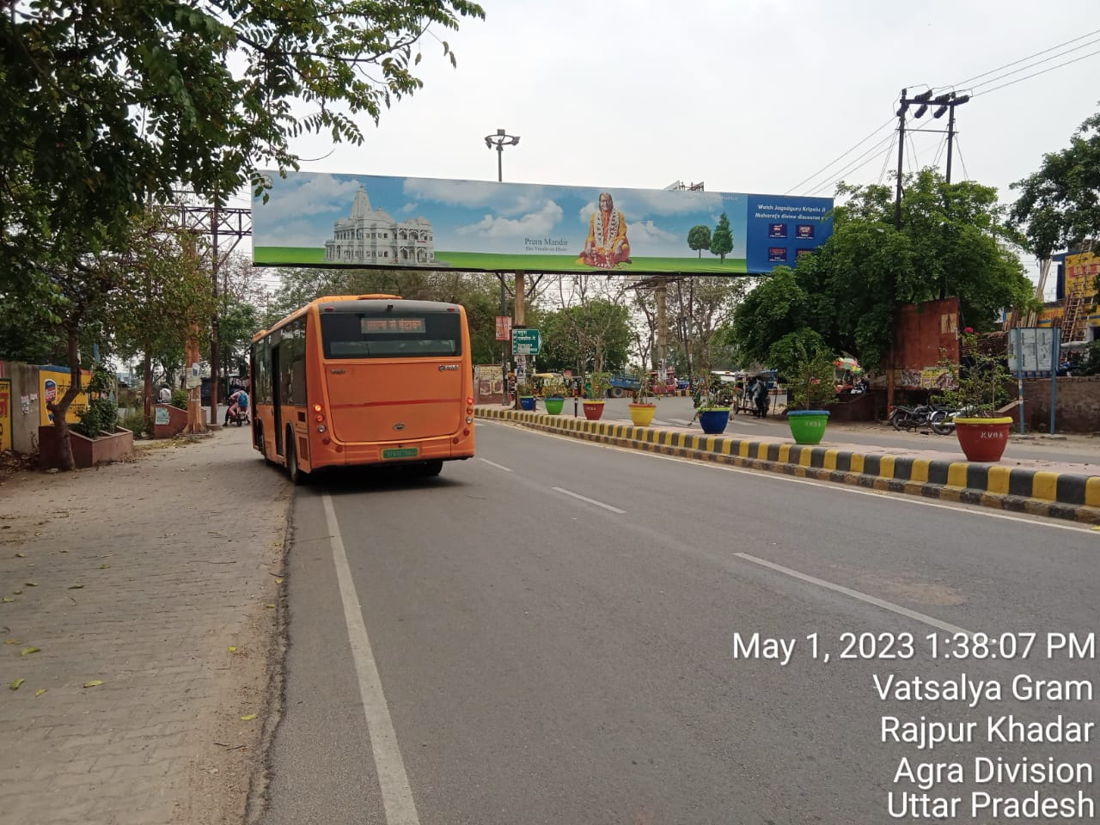
Maya Wati Hospital, Mathura-Vrindawan Road, Facing Prem Mandir 70x10

Slide 8
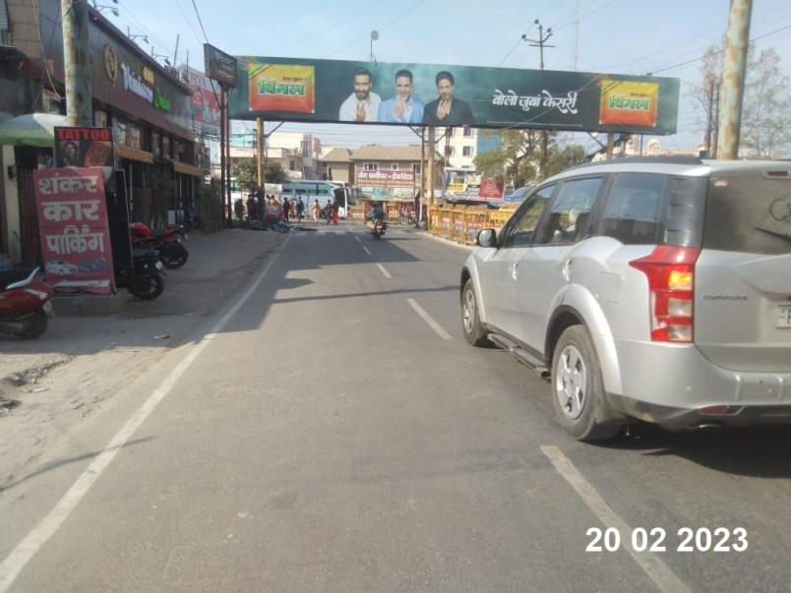
Prem Mandir Xing Facing Mathura 80x10

Slide 9
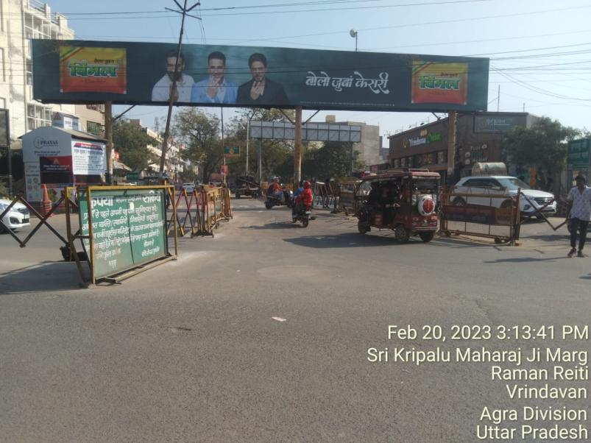
Prem Mandir Xing Facing Chattikara 80x10

Slide 10
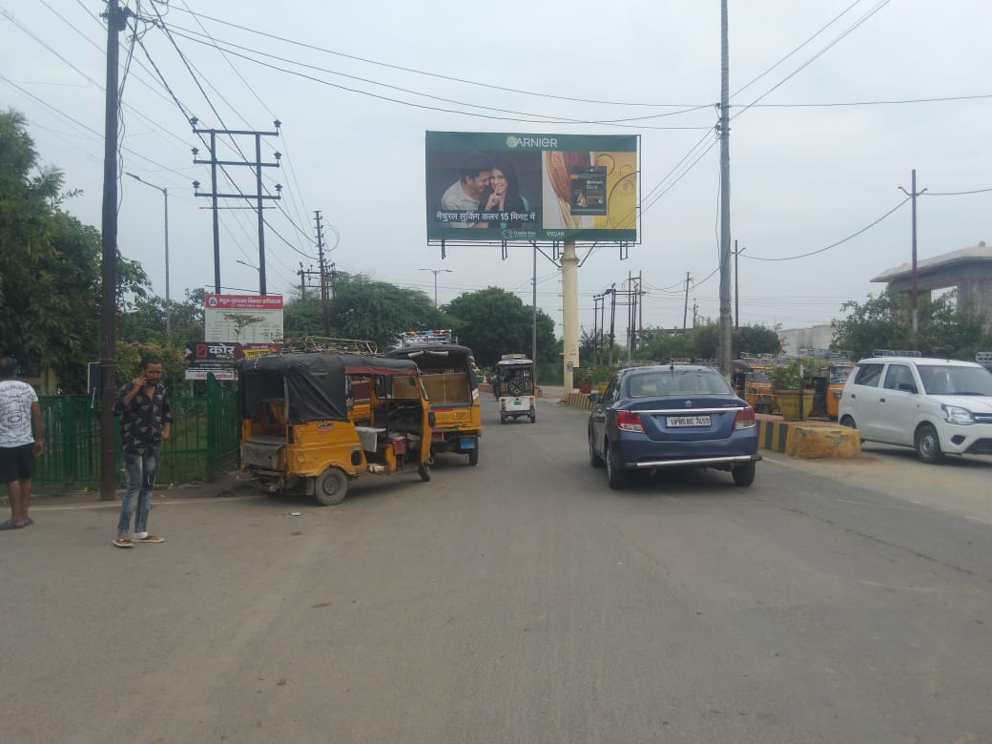
Tourist Complex Information Center, Facing Expressway to Vrindawan 30x15

Slide 11
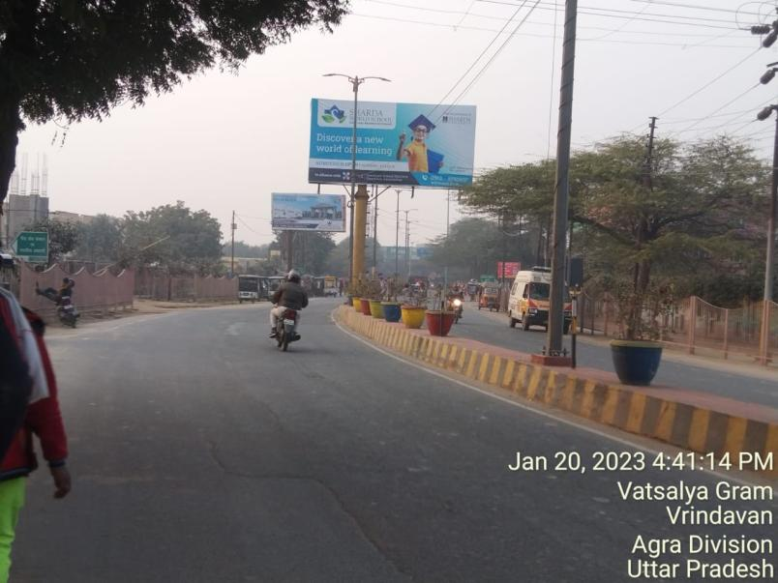
Tourist Complex Information Center, Facing Vrindawan to Expressway 30x15

Slide 12
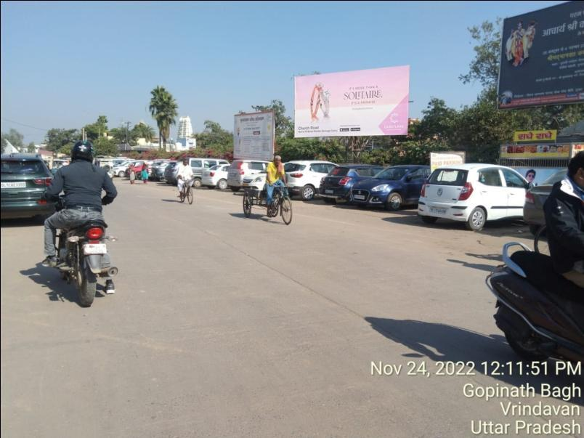
Gandhi Park, Facing Nagar Nigam 20x10

Slide 13
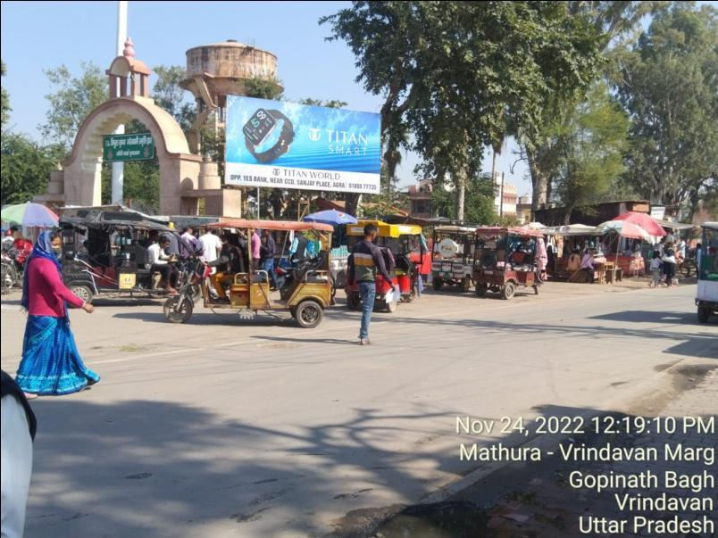
Gandhi Park, Facing Attalla Chungi 20x10

Slide 14
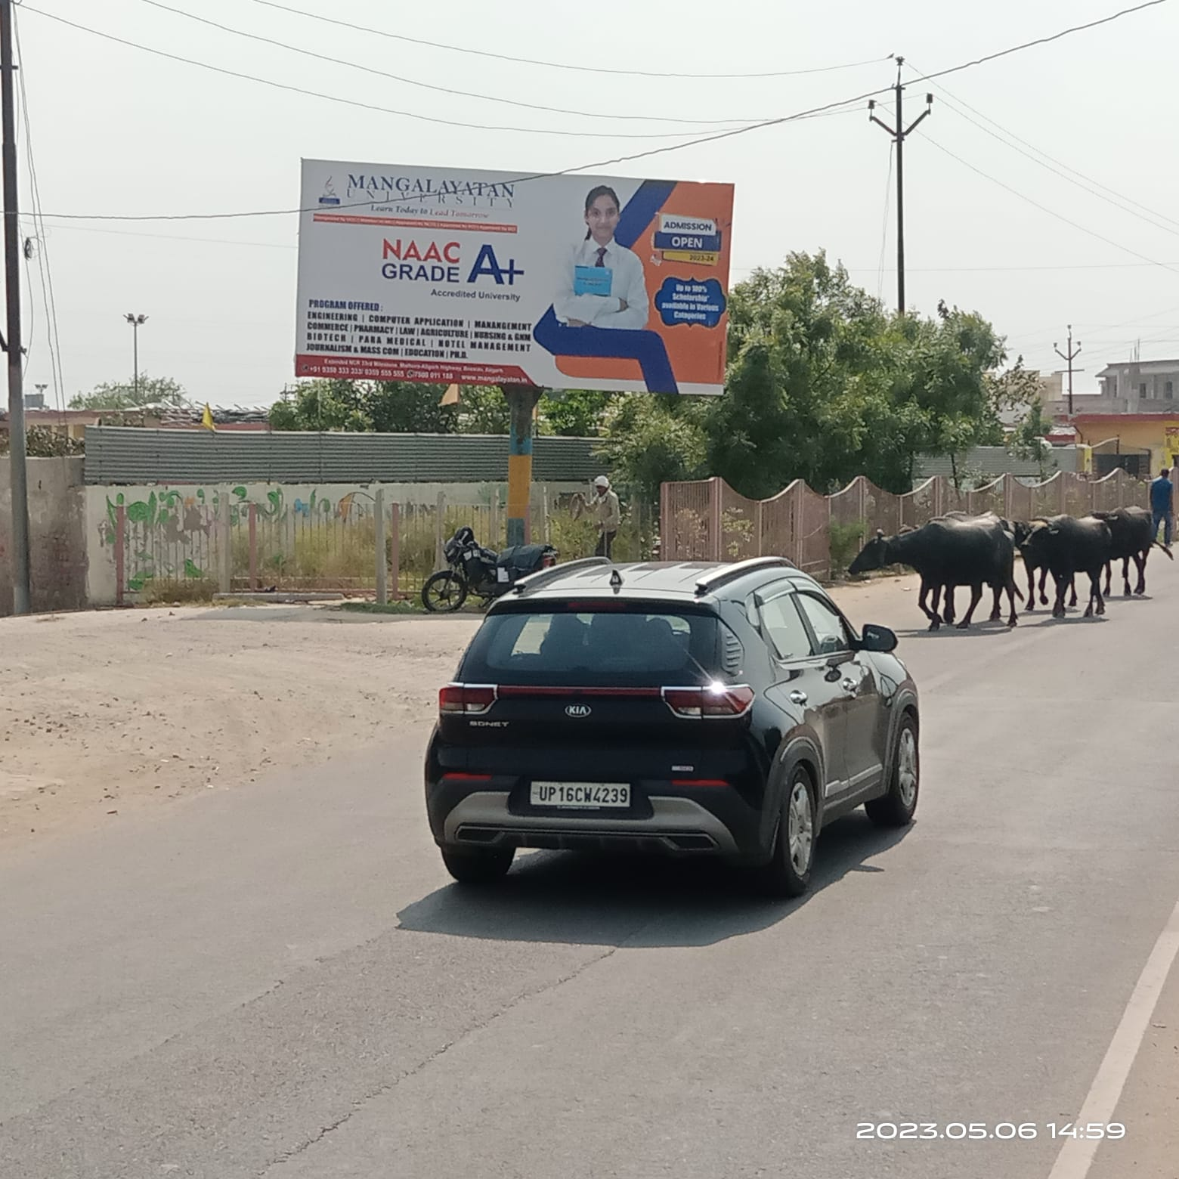
Near Gaushala 20x10

Slide 15
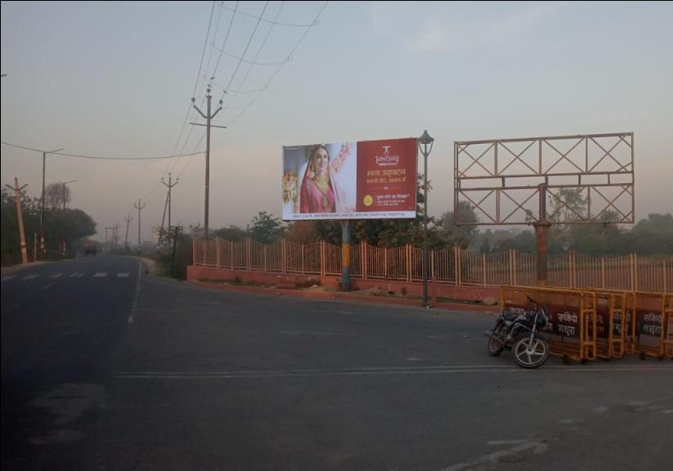
Maant Road, Facing Yamuna Express Highway (1) 20x10

Slide 16
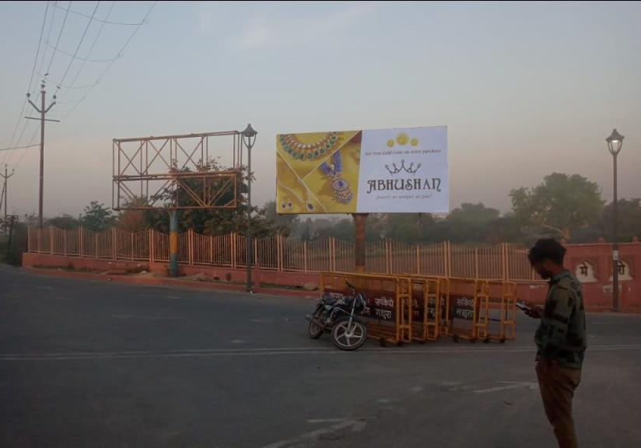
Maant Road, Facing Yamuna Express Highway (2) 20x10

Slide 17
THANK YOU

